Slide 1


Slide 2


И не одну.

Slide 3

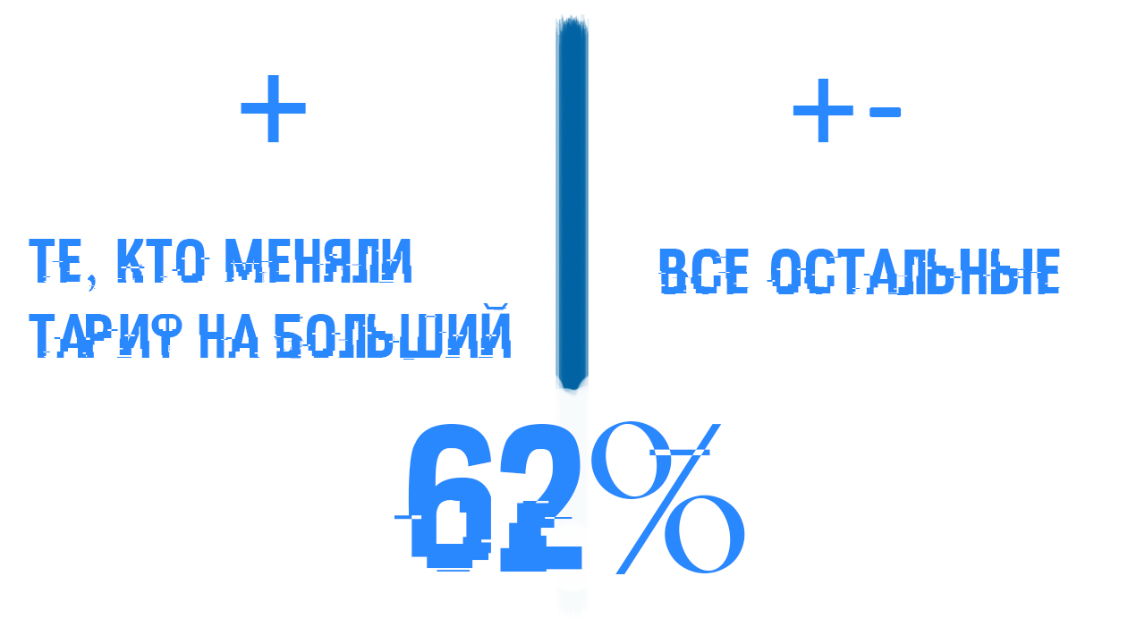
Positive_ID и neutral_ID

Slide 4

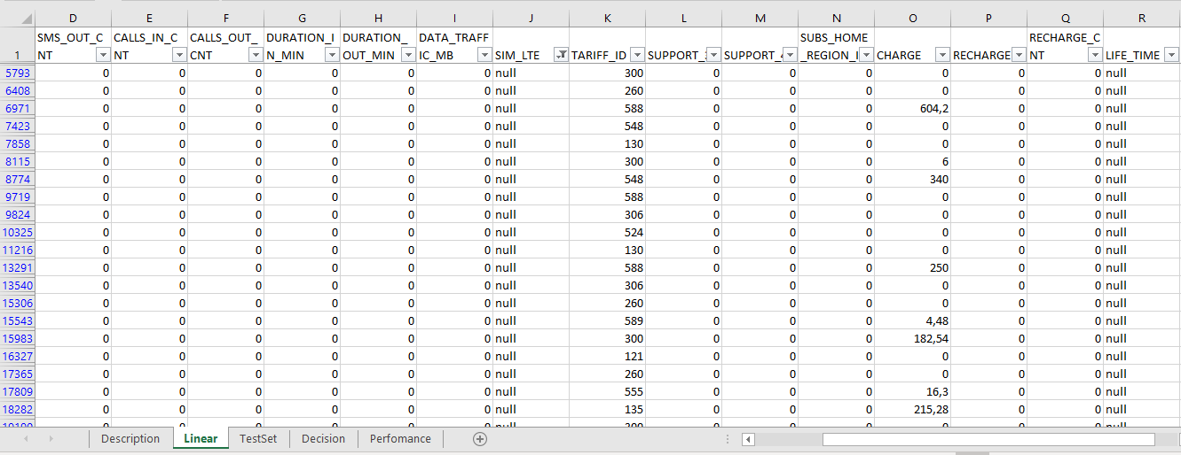
NULL

Slide 5
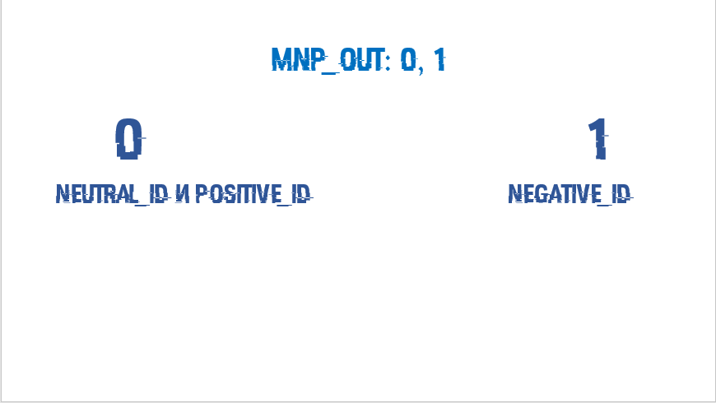
MNP_OUT: 0, 1
0 1
NEUTRAL_ID И POSITIVE_ID NEGATIVE_ID

Slide 6


Slide 7


Slide 8
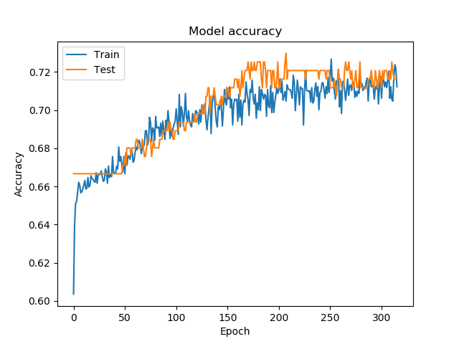
Успех

Slide 9
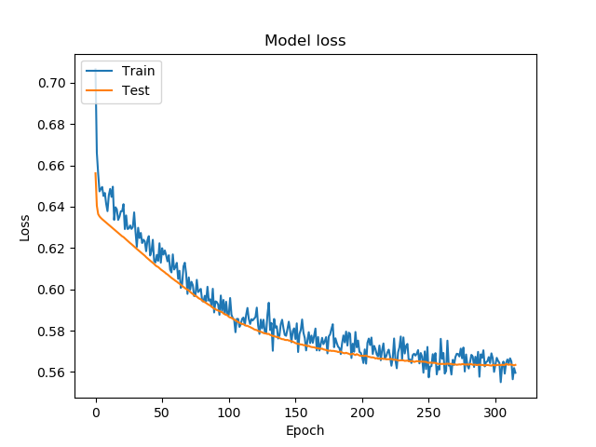
Ошибки

Slide 10


Slide 11


Slide 12
SMS_OUT_CNT | CALLS_IN_CNT | CALLS_OUT_CNT | CHARGE | DATA_TRAFFIC_MB | DURATION_IN_MIN | DURATION_OUT_MIN
MEAN | MEAN | MEAN | MAX | MEAN | MEAN | MEAN
LIFE_TIME | RECHARGE | RECHARGE_CNT | SIM_LTE | SUPPORT_3G | SUPPORT_4G | TARIFF_ID
MEAN | MAX | MAX | CHANGED | MAX | MAX | CHANGED

Slide 13


